Slide 1


Glenn Hills High School’s Reading Initiative
Read 20 Minutes Each Day
(Sustained Silent Reading)
Ms. V. New, M.Ed.
Library Media Specialist
Glenn Hills High School

Slide 2


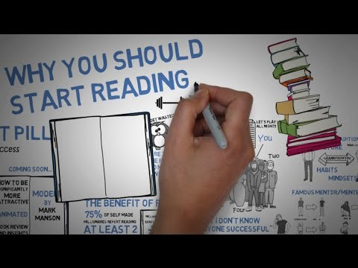
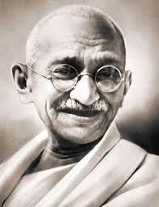
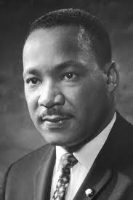



The Benefits of Reading
Watch the video below to understand how reading allows you to pick and choose who you want to add to your inner group of influence that will eventually affect who you become as a person.

Slide 3
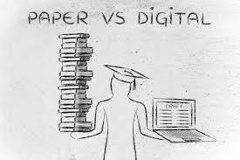

Paper Electronic Reading
VS.
What does research tell us?
Neuroscience research shows that paper-based content reading is better connected to memory in our brains. So, while electronics are becoming more and more prevalent in our day-to-day life, keep printed books the main form of reading. When reading an e-book or an online article, the part of the brain engaged in the activity changes and it no longer is a activity that builds literacy skills. There is no give and take here, electronics should be an enhancement and not a replacement.
Source: southsoundreading.org and Bangor University

Slide 4
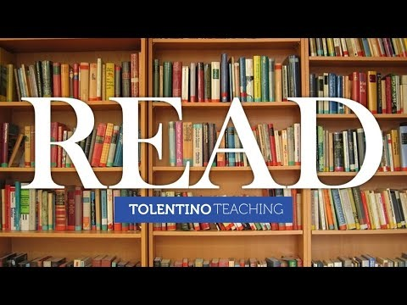
Reading 20 Minutes Each Day
Watch the video to understand how when it comes to reading, every minute counts!
Student “A” Reads 20 Minutes A Day | Student “B” Reads 5 Minutes A Day
1,800,000 words read per year | 282,000 words read per day
3,600 minutes per school year | 900 minutes per school year
Scores in the 90th percentile on standardized tests | Scores in the 50th percentile on standardized tests

Slide 5

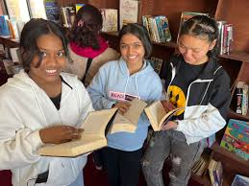
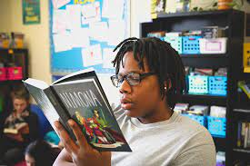

Large image slide
Log Your Reading Minutes Using Beanstack
Beanstack is a reading motivational platform. It has been purchased by the Richmond County School System to encourage students to build a habit of reading and to increase reading stamina.

Slide 6
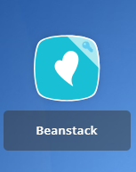

How Do Users Access Beanstack?
Students and teachers may access the Beanstack app by clicking on the Beanstack icon on their single sign in provider, LaunchPad.

Slide 7
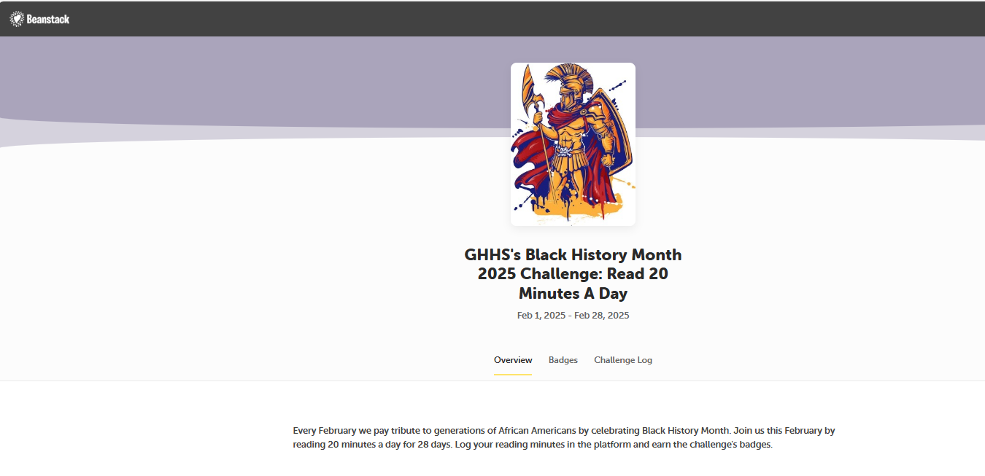
February’s Challenge: Black History Month
Every February, we pay tribute to generations of African Americans by celebrating Black History Month. Join us this February by reading 20 minutes a day for 28 days. Log your reading minutes in the Beanstack platform and earn the challenge’s badges.

